Slide 1
Incidence of HCC after HCV treatment with DAAs: ERCHIVES
Retrospective cohort study
HCV infected Veterans, 2002-2016
Exclusion: HIV or HBV co-infection, HCC prior to baseline, missing information on outcome/follow-up
Data collection: demographics, clinical, laboratory, prescriptions
Baseline
Treatment group (IFN-PEG + RBV or DAA ≥ 28 days ): date of HCV treatment initiation
Untreated group: duration of HCV infection before treatment initiation in the corresponding treated person
SVR: undetectable HCV RNA at least 12 weeks after end of initial treatment
Primary outcome
Incident HCC ≥ 3 months after baseline
Primary analysis performed in persons with baseline cirrhosis (FIB-4 > 3.5)
ERCHIVES
Li DK. Hepatology 2018;67:2244-53

Slide 2
Incidence of HCC after HCV treatment with DAAs: ERCHIVES
Baseline cohort characteristics
 | IFN group (N = 3534) | DAA group (N = 5834) | Untreated group (N = 8468)
Age, median years | 54 | 62 | 58
Male, % | 95.9 | 96.6 | 97.2
Race: white / black, % | 67 / 17 | 51 / 31 | 50 / 35
Diabetes, % | 18 | 31 | 29
Alcohol abuse history, % | 25 | 21 | 33
Smoking history, % | 84 | 82 | 86
HCV genotype: 1 / 2 / 3, % | 29 / 16 / 9 | 85 / 0.2 / 3.3 | 51 / 9 / 4.5
Baseline median HCV, log₁₀ IU/mL | 6.11 | 6.27 | 6.20
PPI use during treatment, % | 38 | 37 | 54
FIB-4 at baseline: no fibrosis, cirrhosis, % | 46 / 13 | 37 / 20 | 49 / 15
Median AFP, IU/mL | 3.2 | 4.3 | 4.01
Ribavirin use, % | 100 | 37 | 0
Treatment duration: ≤ 8W, 12W, 24W | 15 / 19 / 66 | 22 / 74 / 4 | -
Attainment of SVR, % | 66.6 | 96.2
Incident cases of HCC, N (%) | 196 (5.55) | 50 (0.86) | 436 (5.04)
ERCHIVES
Li DK. Hepatology 2018;67:2244-53

Slide 3
Incidence of HCC after HCV treatment with DAAs: ERCHIVES
Incidence rate of HCC in persons with cirrhosis
Treatment Group | Incidence Rate, per 1000 patient-Years | 95% CI | p value (control: IFN)
All persons with cirrhosis IFN-RBV DAA regimens, overall SOF/SMV SOF/LDV Untreated controls | 34.70 25.16 34.84 19.55 45.31 | 28.50 - 42.25 17.98 - 35.21 20.23 - 60.00 11.79 - 32.43 39.42 - 52.08 | - 0.11 0.99 0.04 0.03
SVR₁₂ subgroup IFN-RBV DAA regimens, overall SOF/SMV SOF/LDV | 21.20 22.80 33.26 15.49 | 14.91 - 30.14 15.84 - 32.81 18.89 - 58.56 8.58 - 27.97 | - 0.78 0.18 0.37
Non-SVR₁₂ subgroup IFN-RBV DAA regimens, overall SOF/SMV SOF/LDV | 48.90 62.81 81.24 69.87 | 38.56 - 62.02 26.14 - 150.9 11.44 - 576.7 26.22 - 186.2 | - 0.59 0.61 0.49
ERCHIVES
Li DK. Hepatology 2018;67:2244-53

Slide 4
Incidence of HCC after HCV treatment with DAAs: ERCHIVES
Cumulative probability of HCC development in persons with cirrhosis
0.15
SVR IFN-RBV
SVR DAA
No treatment
0.10
Logrank, p = 0.0004
0,05
0,00
0
6
12
18
24
Mois
SVR IFN-RBV
SVR DAA
No treatment
285
1630
1423
283
1590
1328
280
857
1226
270
297
1080
239
63
933
ERCHIVES
Li DK. Hepatology 2018;67:2244-53

Slide 5
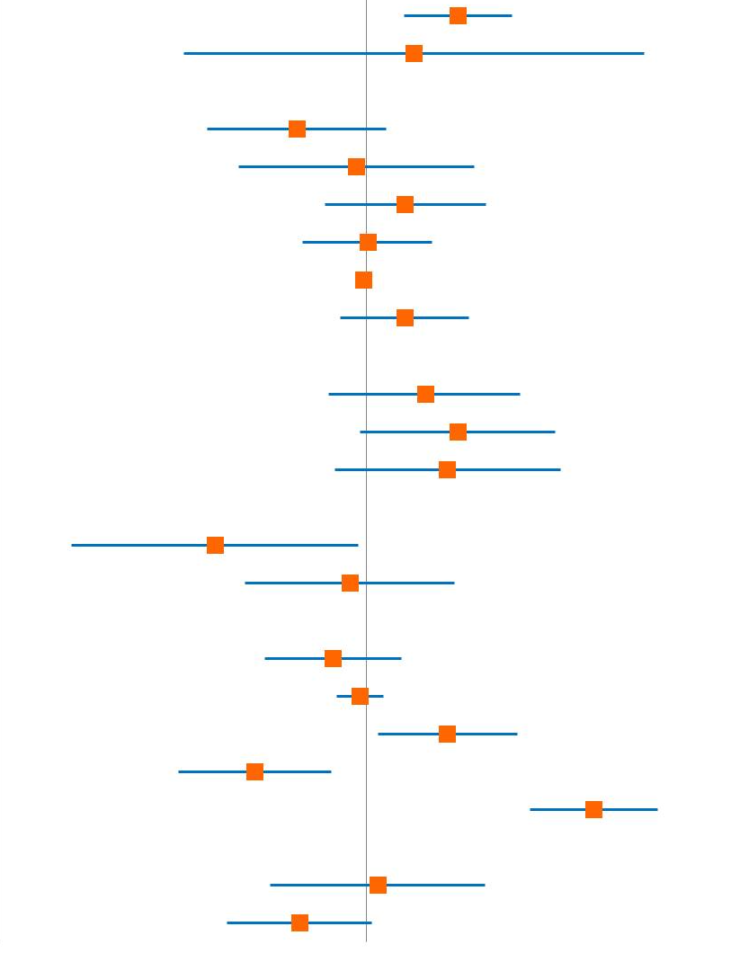
Incidence of HCC after HCV treatment with DAAs: ERCHIVES
Predictors for the development of HCC in persons with cirrhosis, HR (95% CI)
Age, per 10-year increase
Male sex
Race (ref : white)
Black
Hispanic
Other/missing
Diabetes
BMI, per 1-unit increase
Alcohol abuse history
Smoking history (ref : no smoker)
Current smoker
Former smoker
Missing
HCV genotype (ref : genotype 1)
2
3
4, 5, 6
Missing
HCV RNA, per 1 log₁₀ increase
PPI use (baseline onward)
Statin use (baseline onward)
AFP > 20 (vs < 20)
Treatment regimen (ref : PEG-RBV)
Any DAA
Attainment of SVR
1.76 (1.26 – 2.46)
1.34 (0.32 – 5.62)
0.65 (0.37 – 1.13)
0.94 (0.45 – 1.95)
1.27 (0.77 – 2.10)
1.01 (0.67 – 1.50)
0.98 (0.95 – 1.01)
1.27 (0.85 – 1.89)
1.44 (0.79 – 2.60)
1.76 (0.96 – 3.23)
1.65 (0.82 – 3.33)
0.39 (0.16 – 0.95)
0.90 (0.47 – 1.72)
No events (N/A)
0.81 (0.53 – 1.24)
0.96 (0.83 – 1.11)
1.65 (1.07 – 2.55)
0.50 (0.31 – 0.80)
4.10 (2.75 – 6.10)
1.07 (0.55 – 2.08)
0.66 (0.42 – 1.03)
0.1
1
5
10
ERCHIVES
Li DK. Hepatology 2018;67:2244-53

Slide 6
Incidence of HCC after HCV treatment with DAAs: ERCHIVES
Conclusion
DAA treatment is not associated with a higher risk of HCC in persons with cirrhosis with chronic HCV infection in the short term
Previously reported higher rates of HCC associated with DAA treatment may be explained by both the presence of relatively fewer baseline HCC risk factors in persons treated with IFN-RBV as well as selection bias, given that DAA regimens were used to treat persons at higher risk for developing HCC
ERCHIVES
Li DK. Hepatology 2018;67:2244-53

